Slide 1
Lecture 4a
Signaling

Slide 2
So far …
Big picture
Layers
Transmission media
Signals
Analog
Digital
Sinusoid

Slide 3
What is signaling?
Mac OS X Dictionary
“transmit information or instructions by means of a gesture, action, or sound”
Two primary approaches
Baseband analog or digital
Voice on copper cable in landlines
Bits in Ethernet on coaxial or UTP
Bandpass analog or digital
AM/FM radio, Cellular Telephone Signals, Coaxial cable TV

Slide 4
Origins of signals
Analog signals come from sensors of various kinds (e.g., microphones)
Digital signals come from computers and digital devices of various kinds
Question: Do you type in binary?

Slide 5
Source Encoding
Problem: how can we represent alphanumeric characters in bits?
Solution:
Create a mapping between the alphanumeric characters and bits
Object set → Code set
Easier since the set is finite and known
What are design objectives of a code?
How do we encode “analog” data or signals?

Slide 6
Examples of Source Encoding
Object set
Alphanumeric characters
a-z
A-Z
0-9
Special characters (`~!@#$%^&*()-_=+\|{[}}:;””,<.>/?)
Control characters
Code set
{0,1} for binary codes
Can be anything in principle
Code types
Length
Fixed (e.g., ASCII)
Variable (e.g., Morse)

Slide 7
ASCII
American Standard Code for Information Interchange
Design objectives
Universal code for all computers
Unambiguous interpretation of received information by dumb receivers
Standard Code Developed by the American National Standards Institute (ANSI)
Seven bit code (fixed)
Stateless (each object is encoded independently)
Object set
Upper and lower case alphabet
Numbers
Selected keyboard characters
Control characters

Slide 8
Examples in ASCII
Jones
Transmission Direction
J
o
n
e
s
0111010
1101111
1101110
1100101
1110011
A12B3C7
Transmission Direction
A
1
2
B
3
C
7
1000001
0110001
0110010
1000010
0110011
1000011
0110111
Notes:
The transmission direction is important because it clarifies the high order bits from the low order bits. From the ASCII table, bit 7 is transmitted first. Transmission is normally from the high order bit to the low order bit, although it can go both ways.

Slide 9
Local Loop in Landlines
The local loop carries an “analog” baseband voice signal
Created by microphone
Carried on phone wire (copper)
The human ear can perceive frequencies from 20 Hz up to 20 kHz
Voice has “energy” content primarily between 50 Hz and 3400 Hz
The local loop cable and filters truncate the bandwidth to roughly 3500 Hz
…
Central
Office
…

Slide 10
Why Use Analog Transmission?
In place in legacy systems
Sufficient for transmission of voice signals
Or any natural signal that is inherently analog
Significantly less expensive
At the end-point, but not the network
Some transmission media best suited to propagate analog signals
Unguided media (air)
Used in digital cell phones, radio, TV

Slide 11
Why Digital?
Technology
Convergence of computing and communications
MUXs, decoders etc.
Integration
Voice, video, audio all on the same infrastructure
Regeneration
Amplifiers Vs Repeaters
Multiplexing
In time is easy, also in code
Encoding
Most significant advantage
Monitoring/control
Performance tweaking, alarms, etc.
Standardization
Easy to define interfaces
Interoperability

Slide 12
Analog to Digital Transmission
Permits use of digital transmission and switching equipment
Unified communications (treat everything as bits)
Analog signal must be encoded for transmission – termed CoDec (coder/decoder)
Encoding implies conversion to a digital format
Source Coding – more efficient encoding to improve quality or reduce bit rate – vocoder ITU G.729, MPEG video coders

Slide 13
Analog to Digital
Common approach
Sample the analog signal
Signal must be sampled at least at a rate that is twice the maximum frequency component of the signal (Nyquist’s Theorem)
Quantize the samples into a finite number of levels
Assign a set of bits to each level
Bits/sample

Slide 14
Quantization - I
Quantization
sublime
impressive
Wow!
Idea
Suppose the samples of the continuous-time signal are {…, -1.01, 0.83, 0.38, 1.27, … }
We convert them to something like {…, -1, 0.8, 0.4, 1.3, …}
Or we convert them to {…, -1, 1, 0, 1, …}
Which has higher errors?
Error = exact value - approximation
The error samples are {…, -0.01, 0.03, -0.02, 0.03,…} or {…, -0.01, -0.17, 0.38, 0.27, …}

Slide 15
Quantization - II
H - s/2
H
Let the highest analog value be H
Let the lowest analog value be L
We will divide the range (H-L) into N intervals each of size s
So s = (H-L)/N or Ns = (H - L)
Find the midpoint of each interval
H - s
H - 2s
…
…
L + s
L

Slide 16
Quantization - III
Determine where the analog sample lies
Example: Analog value is H - 0.37s
It lies in the interval H - 0.3s and H - 0.4s
Replace the analog value by the midpoint of the interval
Example: Replace H - 0.37s by H - 0.35s
Companding
Compress levels at smaller values, expand levels at higher values

Slide 17
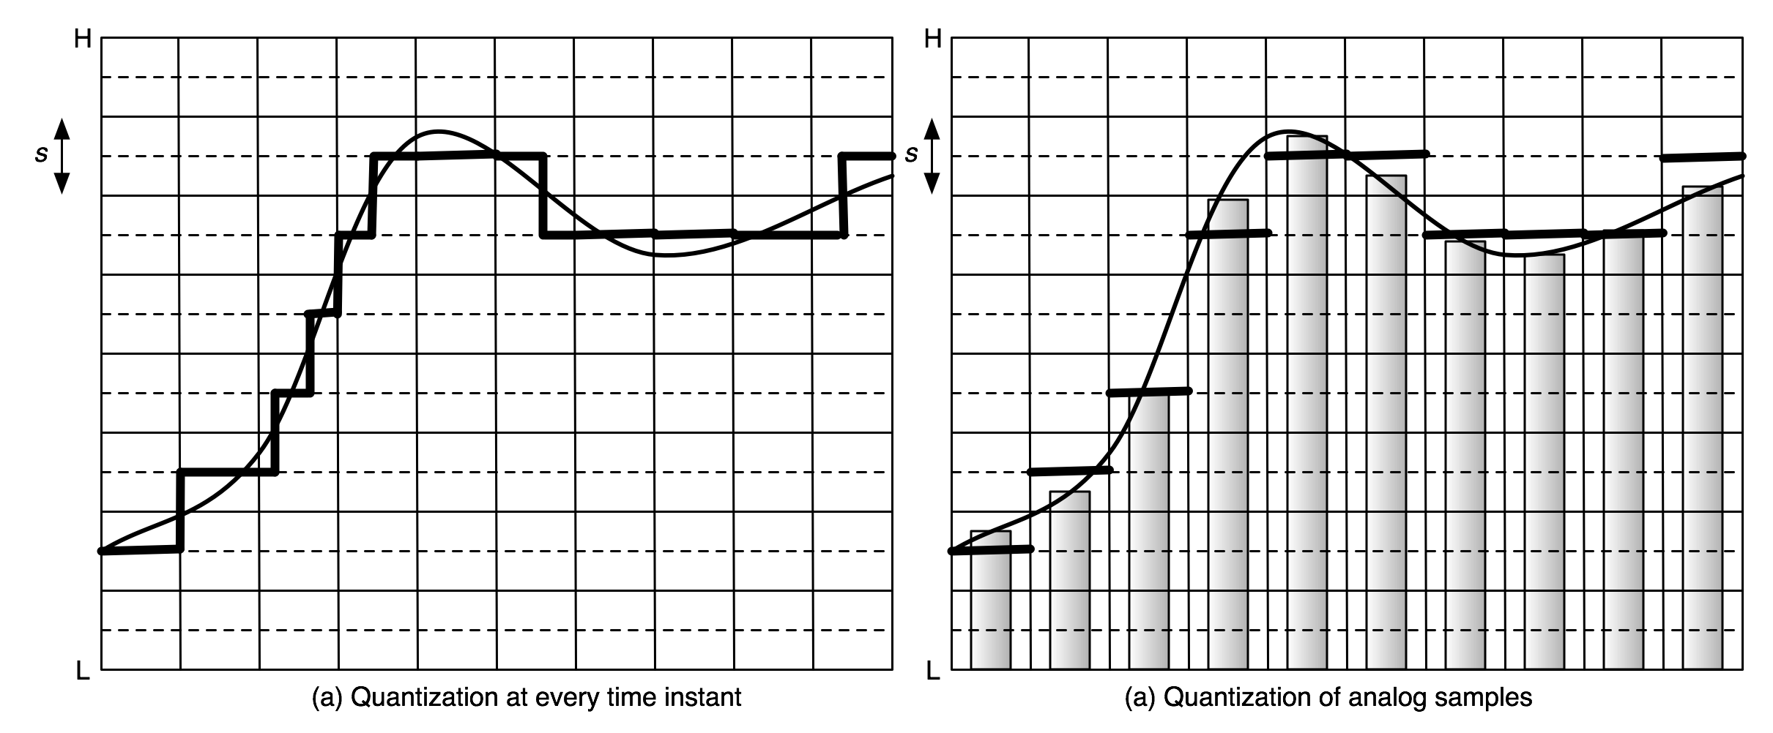
Quantization Example

Slide 18
Why not digital?
Conversion
Where, how and when to convert?
Bandwidth
A 4 kHz voice signal needs 64kbps as a digital signal
See next slide
Delay
Processing of digital signals is easy, but it adds to delays
Synchronization
Where does a bit start? Where does it end?
Quantization noise
Non-linearity of digital signals

Slide 19
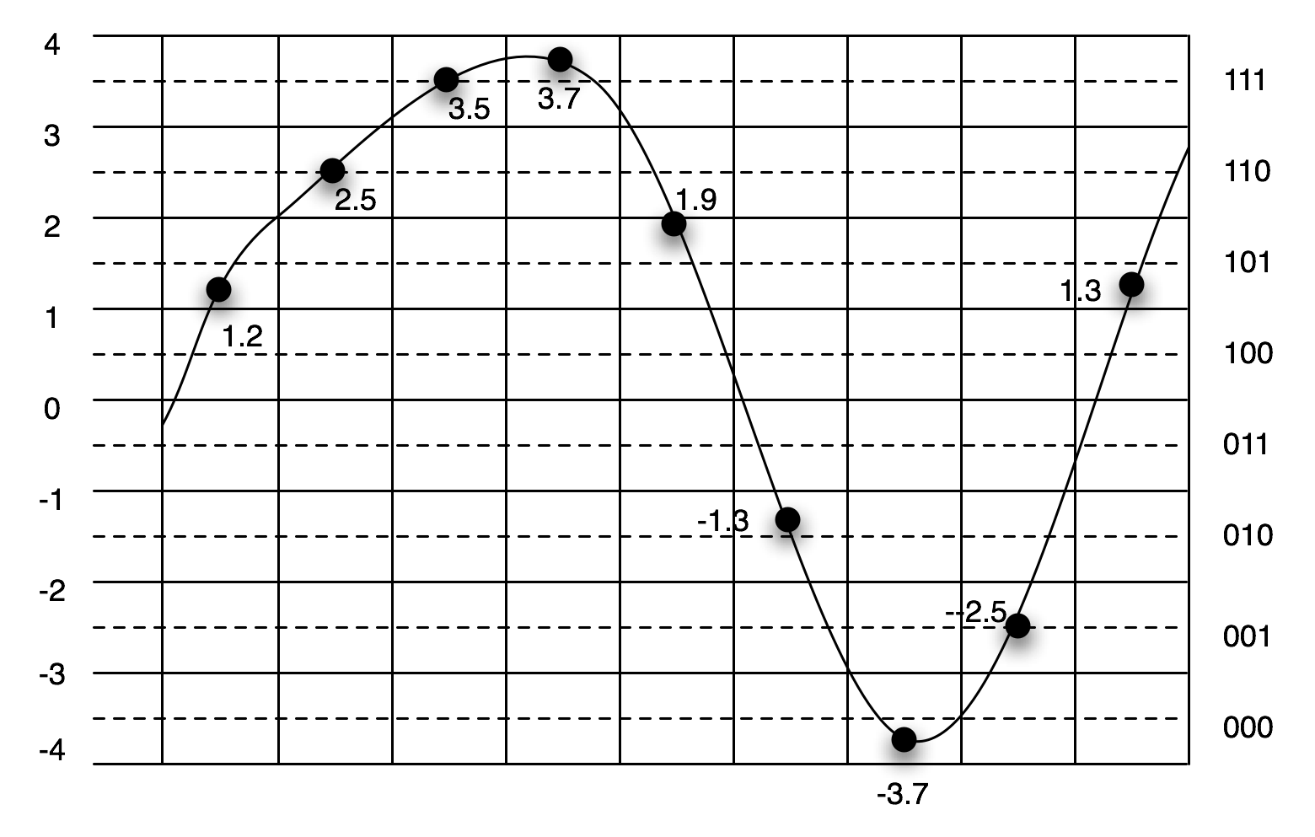
Pulse Code Modulation (PCM)
The conversion of a quantized signal into bits is essentially what we call as “pulse code modulation” or PCM
We use n-bits to represent the samples
Each group of n bits is called a codeword
Example: Analog voice
Sampled 8000 times/second
Either 128 or 256 levels to represent each sample
256 levels = 8 bits => bit rate = 64 kbps
This is the DS0 format

Slide 20
Line Coding
Representing a digital value by an analog signal
Modulation includes a carrier (recall f_{c})
Unipolar return-to-zero (RZ) and unipolar non-return to zero
0
1
0
0
0
1
1
0
T
2T
t
0
1
0
0
0
1
1
0
How many zeros?
T
2T
t

Slide 21
Line Codes
Non Return-to-Zero (NRZ)
Each digital value is represented by a voltage pulse
The voltage value is constant for the entire symbol duration
Return-to-Zero (RZ)
Voltage pulses have duty cycles
They do not last for the entire symbol duration
If the duty cycle is 100%, it becomes NRZ
Unipolar
Signal values are 0V or some positive voltage
Antipodal (or bipolar)
Both positive and negative voltage values (usually identical in magnitude) exist

Slide 22
Comparison of Four Combinations
Bandwidth of a rectangular pulse
Combinations
Unipolar RZ, NRZ and Bipolar RZ, NRZ
Assume RZ has 50% duty cycle
Signal Power
Peak and average
Bandwidth
RZ needs more bandwidth (why?)
Sampling threshold for discrimination
Antipodal has a zero threshold for binary
Transitions
RZ has more transitions, but no difference between unipolar and antipodal
Pulse
Pulse train
Spectrum

Slide 23
Manchester Code
0
1
Used in Ethernet
Signal power
Same as NRZ
Bandwidth
Twice (like RZ)
Transitions

Slide 24
Carrier Modulation
Parameters: amplitude A, frequency f_{c} and phase φ
LSB = Lower Side Band, USB= Upper Side Band
Impressing data on a carrier wave (sinusoid)
The data are contained in some parameters of a sinusoid given by
c(t) = A cos(2πf_{c} t + φ)
The original data signal is called the baseband signal
Modulation moves the spectrum of the signal to a region around f_{c}
We say that the modulated signal is a bandpass signal
Baseband
Bandpass

Slide 25
Why Modulation?
Medium characteristics
Using strictly baseband analog or digital signals is not practical
Radio transmissions
Antenna sizes are smaller as f_{c} increases
Simplifying circuitry
Use of a single intermediate frequency enables us to make best use of hardware components
Multiplexing

Slide 26
Analog Modulation
The amplitude, frequency or phase changes continuously as a function of the baseband signal
AM – Amplitude Modulation
525 – 1715 kHz, Bandwidth = 10 kHz
KDKA
FM – Frequency Modulation
88 MHz – 108 MHz
Bandwidth = 200 kHz
Show AM in Matlab or R

Slide 27
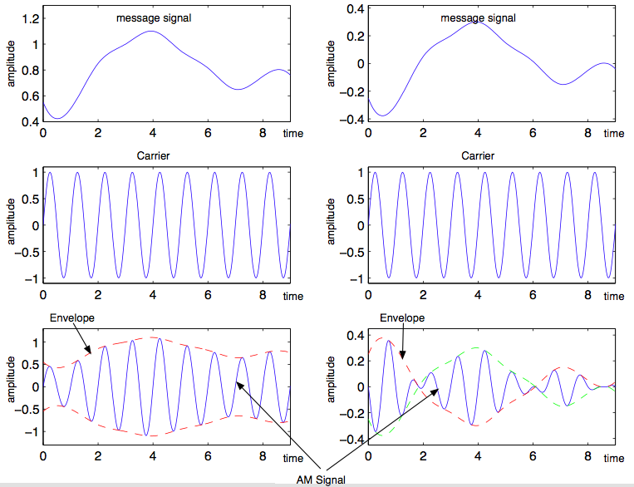
AM Example
Different types of AM exist
Notice that the carrier’s “envelope” is changing
Underneath, we still have a sinusoid

Slide 28
Digital Modulation
The amplitude, frequency or phase change in a discrete manner following the baseband signal
Called amplitude, frequency or phase shift keying (ASK, FSK, PSK)
Discrete symbols represented by specific continuous-time signals lasting for T_{s} seconds
Symbol rate = 1/T_{s}
Binary: One bit per symbol for a total of two different symbols and signals
Symbol rate = bit (data) rate = 1/T_{s}
M-ary: k bits per symbol for a total of 2^{k} = M different symbols and signals
Symbol rate = 1/T_{s}; Bit (data) rate = k/T_{s}
Symbol rate is also called baud

Slide 29
Binary ASK or On-Off Keying
Historically:
Morse code on RF carriers
Today: Photonics, RF-ID tags, television remotes, IR links
How do we write s(t)?

Slide 30
BFSK
Use two different frequencies to represent “0” and “1” Signals are given by:
s_{i}(t)=A cos(2πf_{i}t), 0≤t ≤T_{s} for i =1,2
Send s₁(t) if the bit is zero, send s₂(t) if the bit is one
Signaling in analog (1G) cellular telephones
Bluetooth, Zigbee and sensor networks

Slide 31
BPSK
Use two phases to represent “0” and “1” Signals are given by:
s_{i}(t)=A cos(2πf_{c}t+φ_{i}), 0≤t≤T_{s} for i=1,2
Send s₁(t) if the bit is zero, send s₂(t) if the bit is one
It is common to assume that φ₁ = 0 and φ₂ = π
BPSK is equivalent to antipodal signaling with non-return-to-zero (NRZ) pulses
The transmitter can be simply implemented as a multiplication of the baseband antipodal signal and the carrier at frequency f_{c}

Slide 32
M-Ary Modulation
Quadri-phase Shift Keying (QPSK) uses 4 phases
Each symbol carries 2 bits
Quadrature Amplitude Modulation (QAM) uses both amplitude and phase of a carrier to encode information
Example: 16-QAM symbols carry 4 bits
QPSK and QAM are common in wireless networks
QAM also used widely in cable modems, DSL and dial-up

Slide 33
Signal Constellation
Representation of signals used for communications in a graphical manner
Shows the “distance” between signals
Larger the distance, easier it is for the receiver to distinguish between the signals
More signals => smaller distance for the same power
Error rates

Slide 34
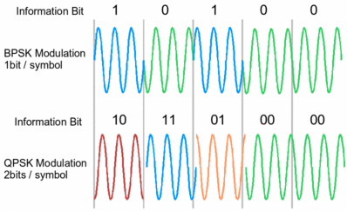
QPSK

Slide 35
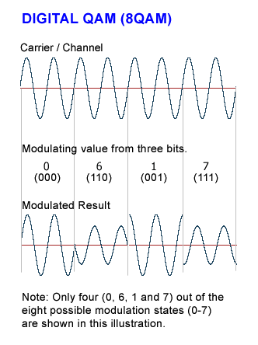
8 QAM

Slide 36
Next
Impairments
Noise, Attenuation, Channel Bandwidth
Error rates and error control coding
Multiplexing

